Slide 1
NF OCONUS to NF OCONUS
Civilian PCS
Briefing
AFPC PCS Unit
January 2026

Slide 2
Agenda
Purpose
Definitions
PCS Process Steps
Selectee Responsibilities
Entrance on Duty
Travel Time
Mandatory Allowances
Discretionary Allowances
PCS Restriction(s)
PCS Tax Notification
PCS Order Status Check
Acronym Listing
Information / Resources

Slide 3

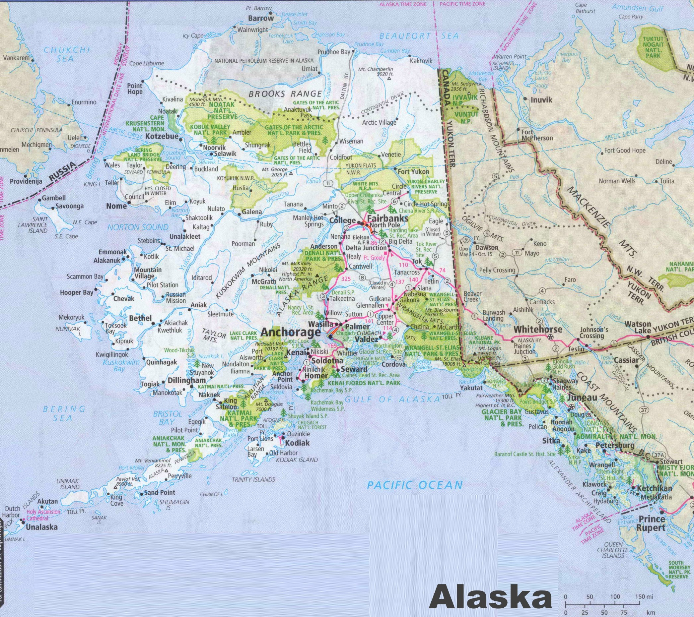
Purpose
Provide information of Civilian Permanent Change of Station (PCS) allowances for a career move from one Non-Foreign Outside the Continental United States (NF-OCONUS) location to another Non-Foreign Outside the Continental United States (NF-OCONUS)
  Example
    Hickam AFB, HI to Elmendorf AFB, AK
  Important! Never make irreversible life changes, such as selling property, resigning from your current position, etc., prior to receipt of a Firm Job Offer and PCS orders

Slide 4
Definitions
Current Federal Civilian Employee: Refers to civilian employees already holding a position within the federal government, to exclude military. This could include other DoD agencies and/or other Federal agencies (including NAF)
Career Program Move: An Air Force centrally paid move to a Centrally Managed (CM) position
Centrally Managed Position: Includes GS-12 and above, when properly identified on the position description and managed by the Career Field Teams (CFT); PCS funded by the Central Salaried Account (CSA) PCS account
Full Government Move: Government arranges HHG transportation.
Split Shipment Move: Employee may ship HHG by Government-procured and personally procured transportation.
Self-Move: Employee arranges their own HHG transportation.

Slide 5
Definitions (con’t)
Dual Federal Employees: When members of the same immediate household, are both transferred in the government’s interest, both members must sign in writing to elect to receive the travel and transportation allowances authorized as one of the following:
  Each employee separately – each employee is eligible for travel and transportation allowances as an employee, but is not treated as the other employee’s dependent
  Only one as an employee – the other employee is eligible for travel and transportation allowances as a dependent
  Duplication of Benefits not Authorized - employee and/or dependents cannot accept or receive duplicate or third-party reimbursement for the employee's covered relocation expenses.
Military Transitioning to Civilian Service: Separating or retiring military members are not considered current federal employees for purposes of their first civilian PCS - they are considered First Duty moves

Slide 6
PCS Process Steps
Step 1 – Human Resources (HR) Staffer initiates PCS process in USA Staffing (USAS)
  (This is the individual that extends the tentative job offer (TJO) to the selectee)
  Assigns PCS-1 and Transportation Agreement (DD Form 1617 or DD Form 1618)
  Completes all required questionnaire fields (Position, Employment, & Change of Station)
  Without all information filled in, selectee will be unable to sign
Step 2 – Selectee completes assigned tasks & signs the PCS-1 & Transportation agreement
  If all areas are not filled in and signed, the staffer WILL NOT be able to initiate the request for PCS Orders
Step 3 – Gaining HRO must complete the Gaining Station Tab in its entirety
Step 4 – HR Staffer confirms tabs are completed and sends request for orders processing template email to the PCS team

Slide 7
PCS Process Steps (con’t)
  Step 5 – PCS Chief
    Assigns myFSS Incident to Technician
Step 6 – PCS Technician processes PCS orders (DD Form 1614)
  Reviews PCS documents in USAS for accuracy
Sends PCS Briefing, technician contact information, and request for any other documents required to selectee, and courtesy copies all involved parties
Establishes Entrance on Duty (EOD) date upon receipt of information / documents
Builds order and forwards for quality control (QC) review
Step 7 – PCS QC
  Reviews DD Form 1614 and cost sheet for accuracy and forwards for authentication
  Centrally managed - AFPC/FMY
  Non-centrally managed - gaining or losing organization

Slide 8
PCS Process Steps (con’t)
Step 5 – PCS Section (Gate Keeper) receives PCS Request
  Reviews documents / PCS forms in USAS
  Builds myFSS case and assigns to PCS Chief when documents are verified complete
  Step 6 – PCS Section Chief assigns PCS case to Technician
Step 7 – PCS Technician processes PCS orders (DD Form 1614)
  Reviews PCS documents in USAS for accuracy
Sends PCS Briefing, technician contact information, and request for any other documents required to selectee and courtesy copies all involved parties
Establishes Entrance on Duty (EOD) date upon receipt of information / documents
Builds order and cost sheet then forwards for quality control (QC) review
Step 8 – PCS Quality Check
  Reviews PCS orders and cost sheet for accuracy and forwards for funding allocation
Step 9 – PCS Technician forwards order for authentication based on position type

Slide 9
Selectee Responsibilities
Ensure all information and documents are accurate and complete in USAS
See the PCS Required Documents List on the link below to help determine what additional documents and / or forms may be required prior to completing your PCS orders
  Examples include:
    Birth certificates and / or custody documents for children under 21 who do not share same last name of the selectee
    Marriage certificate for spouse that does not share same last name of the selectee
    Physician affidavit for children ages 21 and over incapable of self-support
    https://www.afpc.af.mil/Civilian-Career-Management/Civilian-PCS/

Slide 10
Selectee Responsibilities (con’t)
Contact designated PCS Technician if assistance is needed with understanding authorized entitlements and allowances
Once orders are received, contact nearest base transportation management office (TMO) to coordinate movement of household goods (HHG)
Contact local / base travel management company (TMC) to arrange house hunting trip (HHT)
  Submit travel voucher with local finance office upon return of HHT
Submit final travel voucher to base finance office upon completion of PCS

Slide 11
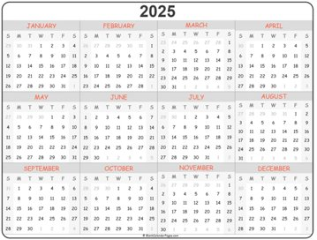
Entrance on Duty (EOD)
TIMELINES FOR ESTABLISHING EOD
  When PCS Technician receives all completed forms and supporting documents, the EOD will be established
  EODs are set at 65 days out for Non-Foreign OCONUS moves
  EODs must be set at the beginning of a new pay period (Sunday)
Example:
Completed PCS-1 and supporting documents were received by PCS technician on 15 Jan 2025.
65 days from that date is 21 Mar 2025. The next
closest pay period begins on 23 Mar 2025;
therefore, the EOD will be 23 Mar 2025.

Slide 12
Entrance on Duty (EOD) (con’t)
  Exceptions: Senior Executive Service (SES), Civilian Strategic Leader Program (CSLP) Base Realignment & Closure (BRAC) & Priority Placement Program (PPP)
    SES / CSLP EODs are set by the organization and orders processed within 72 hours
    PPP EODs are normally set by the organization - must be within 30 days of a valid match for CONUS moves (45 days OCONUS) and orders processed within 72 hours
    BRAC EODs are set and maintained in accordance with base closure timelines

Slide 13
Travel Time
Employee should begin official travel on first duty day following EOD
  It is not required to perform PCS travel on a holiday or weekend, however if travel is performed, those days will be counted as travel days
    Exceptions: RIF, PPP, BRAC, and First Duty Hires
      RIF, PPP and BRAC Employees must travel on losing activity’s time
      First Duty hires will begin travel on their EOD date and will report for their first duty day on their On or About (O/A) date (as of 16 Dec 2024)
Actual Reporting date is determined by number of travel days authorized
  Leave En-Route: Leave taken after departure from the old duty station but prior to arrival at the new duty station must be approved in advance of travel by the gaining supervisor
    If approved, the reporting date will be adjusted

Slide 14
Travel Time
(con’t)
Dependent Travel: If dependent does not travel concurrently with employee, it is considered delayed and must be noted on PCS order
  All travel and transportation must be completed within 1 year from the employee’s date of physically reporting for duty.
  Employee will be responsible for authorized travel and transportation costs incurred after the 1 year anniversary date of the transfer or appointment effective date (Ref: JTR, Para, 053712)

Slide 15
Mandatory Allowances
(1 of 7)
Once an agency decision is made to pay or reimburse relocation expenses all the mandatory allowances must be paid or reimbursed. Ref: JTR Ch. 5 Part F 0536, and FTR §302-3
  The Agency may not negotiate, deny, or reduce these allowances when the civilian employee meets the eligibility requirements.
  Case-by-case factors, such as cost-effectiveness, labor market conditions, and difficulty in filling the vacancy, form the basis for determining whether to offer PCS allowances.
    Budget constraints do not justify denying PCS allowances. Ref: JTR Ch. 5 Part F 053705
  These mandatory allowances include:
    Transportation & Per Diem – Employee & Authorized Dependent(s)
    Miscellaneous Expense Allowance (MEA) when moving a household
    Transportation of Household Goods (HHG), including Storage in Transit (SIT)
    Real Estate/Unexpired Lease Expenses (Not authorized for Retirement / Separation)
    Relocation Income Tax Allowance (RITA)

Slide 16
Mandatory Allowances
(2 of 7)
TRANSPORTATION & PER DIEM - Employee & authorized dependent(s)
Includes travel between old and new Permanent Duty Station (PDS) – Privately Owned Vehicle (POV), airfare (if applicable), lodging, meals & incidentals while in a travel status
It is mandatory policy for all travelers to use an available Travel Management Company (TMC) for all official transportation requirements
If airfare is utilized, employee must book with a contracted carrier
It is general policy of DoD that the Gov’t Travel Charge Card (GTCC) be used to pay for official travel and transportation related expenses
  If individual is not a GTCC holder, tickets should be purchased using a GTCC centrally billed account (CBA)
  Rental Car reimbursement at Gov’t expense for PCS travel is NOT authorized
Employee and Dependent travel must be completed within 1 year from the employee’s transfer or appointment effective date

Slide 17
Mandatory Allowances
(3 of 7)
MISCELLANEOUS EXPENSE ALLOWANCE (MEA) when moving a household
  Fixed rate paid at $905 w/out dependents & $1,810 w/dependents
  Actual reimbursement may be authorized
    Employees with dependents - reimbursement cannot exceed two weeks of employee’s basic salary rate
    Employees without dependents – reimbursement cannot exceed one week of
  employee’s basic salary rate
    Information on MEA, and types of expenses covered, can be accessed on the myFSS website under knowledge articles at: https://myfss.us.af.mil/USAFCommunity/s/knowledge-detail?pid=kA0t0000000LHJSCA4
  First duty station moves, SES last moves, separation and retirement moves not eligible

Slide 18
Mandatory Allowances
(4 of 7)
TRANSPORTATION OF Household Goods (HHG), INCLUDING Storage in Transit (SIT)
  HHG authorized up to 18,000 lbs plus 2,000 (or 10 percent) of packing material allowance
  Must be shipped within 12 months of the date employee physically reported to duty at new duty location
  Government Bill of Lading (GBL) - Govt arranges w/carrier & responsible for payment
  Self-Move - Employee arranges their own HHG transportation and pays for the move
      Reimbursement is limited to the actual expenses incurred by the employee, NOT TO EXCEED the cost of a government arranged move

Slide 19
Mandatory Allowances
(5 of 7)
TRANSPORTATION OF HHG, INCLUDING SIT (Cont’d)
Transportation of mobile home (including a boat) used as a primary residence in lieu of HHG transportation (not to exceed cost of HHG shipment)
The worldwide maximum weight of HHG that may be transported (and/or stored ICW transportation) is 18,000 lbs. The employee is financially responsible for HHG-related costs incurred for excess weight (Ref: JTR, Para 054304)
Information on HHG can be accessed on the myFSS website at: https://myfss.us.af.mil/USAFCommunity/s/knowledge-detail?pid=kA0t0000000LHJsCAO
Information on SIT can be accessed on the myFSS website at:
https://myfss.us.af.mil/USAFCommunity/s/knowledge-detail?pid=kA0t0000000LHJiCAO

Slide 20
Mandatory Allowances
(6 of 7)
REAL ESTATE/UNEXPIRED LEASE EXPENSES (not authorized for Retirement / Separation, First Duty Station Moves, Early return of Dependents, TCS)
May be authorized reimbursement for certain expenses for the sale of residence at old PDS and/or purchase of a residence at new PDS
Reimbursement of expenses for settlement of an unexpired lease at old PDS in lieu of real estate sale expenses
Residence at old PDS must be actual residence at time of transfer (where regularly commute to and from work)
Real Estate sale and/or purchase transaction must be completed no later than anniversary date that the employee physically reported for duty at new location 1-year
An extension may be requested in very limited circumstances
Written extension requests MUST be submitted no later than 30 calendar days after the 1-year expiration date (JTR, Para 053607 and DAFMAN 36-142, Para 5.8.3.3.2.)

Slide 21
Mandatory Allowances
(7 of 7)
REAL ESTATE/UNEXPIRED LEASE EXPENSES (Cont’d)
Information on Real Estate / Unexpired Lease Expenses can be accessed on the myFSS website at:
https://myfss.us.af.mil/USAFCommunity/s/knowledge-detail?pid=kA0t0000000LHJkCAO
Relocation Income Tax Allowance (RITA)
  Certain PCS entitlements & allowances are taxable to Federal & State
  RITA is designed to compensate relocating employees for additional tax liability they incur as a result of a Gov’t paid PCS move
  Information on RITA can be accessed on the myFSS website at:
  https://myfss.us.af.mil/USAFCommunity/s/knowledge-detail?pid=kA0t0000000LHJwCAO

Slide 22
Discretionary Allowances
(1 of 10)
Unlike Mandatory Allowances that must be paid if an employee meets the eligibility requirements, Discretionary Allowances are authorized at the discretion of the employing activity / DoD Component
These discretionary allowances may or may not include:
  House Hunting Trip (HHT)
  Temporary Quarters Subsistence Expense (TQSE)
  Privately Owned Vehicle (POV) Shipment
  Defense National Relocation Program (DNRP)
  Property Management Service (PMS)
  Non-Temporary Storage (NTS) (Extended Storage) of HHG
If PCS is locally funded (non-centrally managed move), check with the gaining organization for authorized allowances

Slide 23
Discretionary Allowances
(2 of 10)
HOUSE HUNTING TRIP (HHT): travel to arrange permanent residence before arrival at new PDS
HHT may be taken “only” after the travel authorization (PCS Order) has been issued
Maximum of 5 calendar days for CP funded & 10 calendar days for NCP funded (includes weekends)
  Pays for round-trip travel and per diem for employee and / or spouse (domestic partner not authorized)
  Rental car, if flying
    Employee will contact local DTMO or TMC on base to book HHT travel (commercial air, rental vehicle) -- do NOT use the Defense Travel System (DTS)
  Authorized when old and new PDS are greater than 75 miles apart (If driving, cannot be greater than 250 miles)
May be reimbursed as Actual Expense (Lodgings Plus) or Fixed (Lump Sum)
  Once Lump Sum is selected reimbursement method is irrevocable

Slide 24
Discretionary Allowances
(3 of 10)
HHT (Cont’d)
  An employee is considered in a duty status while performing HHT travel and will not be charged leave Ref: FTR Chap 302, Subchapter C, Part 302-5, Para 302-5.17
  HHT information can be accessed on the myFSS website at: https://myfss.us.af.mil/USAFCommunity/s/knowledge-detail?pid=kA0t0000000LHJNCA4

Slide 25
Discretionary Allowances
(4 of 10)
SEEKING RESIDENCE: Looking for permanent residence upon arrival at new PDS
May only be used in lieu of HHT (not authorized HHT and Seeking Residence)
  For centrally managed positions (CP), employee allowed excused leave not to exceed 5 calendar days upon arrival at new duty station
  For non-centrally managed positions (NCP), up to 10 calendar must be approved by gaining supervisor
  Expenses are claimed under the Temporary Quarters Subsistence Expenses (TQSE) method elected, not in addition to authorized TQSE.
  Rental Car is NOT authorized at Gov’t expense
  Information on Seeking Residence can be accessed on the myFSS website at: https://myfss.us.af.mil/USAFCommunity/s/knowledge-detail?pid=kA0t0000000LHJxCAO

Slide 26
Discretionary Allowances
(5 of 10)
TQSE
  Intended to partially reimburse an employee and/or dependent(s) for expenses incurred as a result of occupying temporary quarters while seeking a permanent residence in conjunction with a PCS
  TQSE Lodgings Plus (LP) is the preferred TQSE reimbursement method(default IAW JTR Para 054201)
  TQSE (LP) – Reimbursed 60 days based on the locality rate of the old or new PDS, or combination thereof, wherever temporary quarters will be occupied; Limited extensions may be granted
      Up to 60 days for non-centrally managed positions (as defined by gaining unit)
  All TQSE options are outlined in the JTR 054201, TQSE Types. Any election other than TQSE (LP) must be made in writing before any part of the order has been executed by sending an email to: afpc.dpczpp.pcsamendmentquestion@us.af.mil however, once order has been executed, election is irrevocable.

Slide 27
Discretionary Allowances
(6 of 10)
TQSE (Cont’d)
  Employee will arrange lodging through a private or commercial source (e.g., a hotel)
Employee should retain lodging receipts or other proof that temporary lodging was occupied
  General information on TQSE can be accessed on the myFSS website at:
  https://myfss.us.af.mil/USAFCommunity/s/knowledge-detail?pid=kA0t0000000LHJYCA4
  To request an extension to TQSE for Centrally managed orders, please send an email to: afpcresourcesoffice@us.af.mil
  For non-centrally managed positions, contact your Civilian Personnel Section (CPS)

Slide 28
Discretionary Allowances
(7 of 10)
Privately Owned Vehicle (POV) SHIPMENT (in lieu of driving):
If authorized, only one POV may be shipped at government expense
Contact the nearest TMO for shipment arrangements
Alaska Only: Up to two POVs may be shipped at government expense
  May be authorized if it is more advantageous and cost effective to transport POV(s) to new PDS by commercial means than to have the traveler and/or immediate family member(s) drive one or two POVs (if applicable) to new PDS
  Up to two POVs may be authorized if two licensed drivers are authorized on the order
Costs considered are:
  Cost of employee traveling by POV, transporting the POV(s), travel if the POV(s) is / are transported; and
  Productivity benefit from the traveler’s accelerated arrival at the new PDS
  Distance between authorized origin and new PDS must exceed 600 miles

Slide 29
Discretionary Allowances
(8 of 10)
POV SHIPMENT (in lieu of driving) (Cont’d):
If POV shipment is authorized at Gov’t expense, reimbursement is limited to the traveler’s actual expenses not to exceed POV transportation cost from authorized origin point to authorized destination and arrangements will be made by traveler
Employee must provide the following documentation for consideration:
  Justification for accelerated travel, if applicable
  Proof POV is in operating order and proof of insurance
  Legal title and registration
  Current driver’s license of traveler cited on PCS order
  Number of POV(s) requesting to be shipped
  Quote for shipment (traveler arranged)
Information on POV Shipment can be accessed on the myFSS website at: https://myfss.us.af.mil/USAFCommunity/s/knowledge-detail?pid=kA0t0000000LHJaCAO

Slide 30
Discretionary Allowances
(9 of 10)
DoD NATIONAL RELOCATION PROGRAM (DNRP) GUARANTEED HOME SALE (GHS)
  Open to all centrally managed GS-12 and above
  Must be authorized “Real Estate” and “Relocation Services” on orders
  Eligible employee must elect to use GHS and complete sale transaction prior to one-year real estate time limit – should enroll NLT 120 days before one-year expiration date
  Employees are no longer required to market their home prior to enrollment in DNRP. Employees will initially be enrolled in DNRP Basic for a period of time before being eligible to enroll in DNRP Plus.
  GHS applicants funded by AFPC must cite point of contact name listed in Block 28 of PCS order and include the HR contact E-mail: afpcresourcesoffice@us.af.mil
  DNRP handbook and GHS Application Procedures: http://www.nab.usace.army.mil/BusinessWithUs/RealEstate/DNRP.aspx

Slide 31
Discretionary Allowances
(10 of 10)
DNRP & GHS (Cont’d)
  Information on DNRP can be accessed on the myFSS website at: https://myfss.us.af.mil/USAFCommunity/s/knowledge-detail?pid=kA0t0000000LHJzCAO
PROPERTY MANAGEMENT SERVICES MYFSS (PMS)
  Applies only to those eligible for DNRP – occupying a centrally managed position at GS-12 or higher
  PM may be used in lieu of DNRP Guaranteed Home Sale (GHS) for CONUS to CONUS moves IF PM services are advantageous to Gov’t and more cost effective for Gov’t than sale of employee’s residence
  When authorized, employee bears costs up front and may request reimbursement at a minimum of every 6 months, but not to exceed 12 months
  If eligible, employee must submit a request for authorization of PM Services to: afpcresourcesoffice@us.af.mil
  Additional information on PMS can be accessed on the myFSS website at: https://myfss.us.af.mil/USAFCommunity/s/knowledge-detail?pid=kA0t0000000LHJyCAO

Slide 32
PCS Restrictions
The JTR restricts any employee who is serving under a services agreement (formerly transportation agreement) as a result of a Gov’t sponsored PCS move from a second PCS move within a 12-month period (Ref: JTR, Para 053706)

Slide 33
PCS Tax Notification
In accordance with the Tax Cuts and Jobs Act (TCJA) 22 Dec 2017, moving expenses and relocation payments paid by an employer on and after January 1, 2018, are taxable.
  Air Force reports transportation cost associated with a move to the IRS and pay the taxes on behalf of the employee
    This creates a debt to the Air Force and a tax liability to the employee
    Employee will be notified of the debt via mail
    Air Force offers several repayment plan options
      There is NOT a waiver option for tax indebtedness
  ***A Travel W-2 will be processed at the end of the year and will include the increase in gross income, taxes for all PCS-related vouchers filed, and HHGs. W-2s will be mailed to employees and are also available through myPay. Employees will file their tax return for the calendar year and subsequently file a Relocation Income Tax Allowance (RITA) voucher to help offset the additional tax burden imposed by the PCS move. This is not a 100-percent dollar for dollar offset as each individual’s tax situation is unique.***

Slide 34
PCS Order Status Check
Selectee can check the status of their PCS order 24 hours a day by accessing the MyPers website at: https://myfss.us.af.mil/USAFCommunity/s/
Status | Description
RECEIVED – PENDING ASNG TO TECH | Chief of the PCS Unit has received request for PCS orders, and is determining which PCS Tech to assign
CLERK PREPARING | PCS Tech has received request and is building PCS orders
AWAITING OTHER DOCS | PCS Tech is unable to complete processing of PCS orders and has contacted employee for further documents / information
QC COMPLETE | PCS orders have been completed, an additional quality check review has been completed
RETURNED/CORRECTIONS | PCS orders have been returned to PCS Tech for corrections
CM/LOCAL AUTHENTICATION | AFPC or Local Finance are authenticating the orders
PENDING APPROVAL | PCS order has been certified and is now pending final approval
CLOSED | PCS order request is complete and closed
CWOA SOLVED (CLOSED WITHOUT ACTION SOLVED) | PCS order request has been closed without action. For example: employee declines the job offer after initially accepting and starting the PCS process

Slide 35
Acronym Listing
(1 of 4)
AFMAN – Air Force Manual
AFPC – Air Force Personnel Center
BRAC – Base Re-Alignment and Closure
CFT – Career Field Team
CSA – Central Salaried Account
CPS – Civilian Personnel Section
CONUS – Continental United States (48 contiguous states)
CTO – (Contracted) Commercial Travel Office
DoD – Department of Defense
DTMO – Defense Travel Management Office
DNRP – Defense National Relocation Program

Slide 36
Acronym Listing
(2 of 4)
DSSR – Department of State Standardized Regulations
EOD – Entrance on Duty
FTA – Foreign Transfer Allowance
GHS – Guaranteed Home Sale
GTCC – Government Travel Charge Card
HHG - Household Goods
HHT – House Hunting Trip
HR – Human Resources
JTR – Joint Travel Regulations
KCP – Key Career Position
MEA – Miscellaneous Expense Allowance

Slide 37
Acronym Listing
(3 of 4)
MYFSS – My Force Support Squadron
NF OCONUS – Non-Foreign OCONUS (Alaska, Guam, Hawaii, and other U.S. territories)
NTS – Non-Temporary Storage
OCONUS – Outside the Continental United States (Europe, Asia etc.)
OPM – Office of Personnel Management
PCS – Permanent Change of Station
PDS – Permanent Duty Station
PMS – Property Management Services
POV – Privately Owned Vehicle
PPP – Priority Placement Program
RIF – Reduction in Force

Slide 38
Acronym Listing
(4 of 4)
RITA – Relocation Income Tax Allowance
SIT – Storage in Transit
TJO – Tentative Job Offer
TMO – Transportation Management Office
TQSA – Temporary Quarters Subsistence Allowance (OCONUS ONLY)
TQSE – Temporary Quarters Subsistence Expense (CONUS & NON FOREIGN OCONUS ONLY)
USAS – USA Staffing

Slide 39
Information / Resources
PCS Videos are available at: https://www.afciviliancareers.com/regulatory/
For Entitlements and Allowances / Joint Travel Regulation
  https://www.defensetravel.dod.mil/Docs/perdiem/JTR.pdf
For all Household goods, POV shipment and GBL cost comparison related questions contact your nearest TMO
  https://move.mil/
  http://www.defensetravel.dod.mil/index.cfm
For reimbursement, travel rates and other finance related questions contact your gaining Comptroller Squadron civilian pay office
  https://www.dfas.mil/CivilianEmployees/Civilian-Permanent-Change-of-Station-PCS/
Department of State Standardized Regulations (DSSR)
  https://aoprals.state.gov/
DAFMAN 36-142, Civilian Career Field Management and Centrally Managed Programs
  https://static.e-publishing.af.mil/production/1/af_a1/publication/dafman36-142/dafman36-142.pdf

Slide 40

The Air Force’s Personnel Center

